Slide 1
OAA Web-Based Grants Management Portal
September 25, 2024
Matt Terrill
OAA Sr. Business Analyst

Slide 2
Introductions
Charlie Lintecum – Director of Operations
Matt Terrill – Business Analyst
Sharekka Bridges – Sr. Grants Compliance Analyst

Slide 3
Agenda
Portal Features
Registration/Access
System Overview
Grant Application Walkthrough

Slide 4
Applications Cycle and Portal Dates
Activity | Date | Comments
Dec. Applicants Training | 9/25/2024 | Applying for Dec. Grants Committee decision
Application Window Opens: | 10/1/2024 | System official launch!
Abatement Academy Webinar: | 10/10/2024 | For how to use the new system
Optional Drafts by: | 10/21/2024 | (only for Dec. Grants Committee consideration)
Open Q&A/Support Webinar: | 10/30/2024 | Open hour for questions and/or tech issues
Applications Submitted by: | 11/4/2024 | (only for Dec. Grants Committee consideration)
Grants Committee Meeting: | 12/6/2024
Optional Drafts by: | 1/13/2025 | (only for Feb. Grants Committee consideration)
Open Q&A/Support Webinar: | 1/22/2025 | Open hour for questions and/or tech issues
Applications Submitted by: | 1/27/2025 | (only for Feb. Grants Committee consideration) Last opportunity for new or amended Individual Distributions and amended Cooperative applications for FY2025
Grants Committee Meeting: | 2/21/2025
Optional Drafts by: | 3/10/2025 | (final draft review option for 2024-2025 app cycle)
Open Q&A/Support Webinar: | 3/12/2025 | Open hour for questions and/or tech issues
Open Q&A/Support Webinar: | 3/19/2025 | Open hour for questions and/or tech issues
Open Q&A/Support Webinar: | 3/26/2025 | Open hour for questions and/or tech issues
Applications Submitted by: | 4/1/2025 | (for New, Amend, or Renewal applications for FY2026)
Grants Committee Meeting: | 5/23/2025

Slide 5
Portal Features
Individual Distribution and Cooperative Partnership Grant Applications
Annual Reporting For Each Grant
Grant Historical Lookup Including Cooperative Partnership Records for Non-Fiscal Agents
Direct Distribution Reporting
Estimated Funds Lookup

Slide 6
City and County Registration

Slide 7
Dashboard Overview

Slide 8
Dashboard Overview cont.

Slide 9
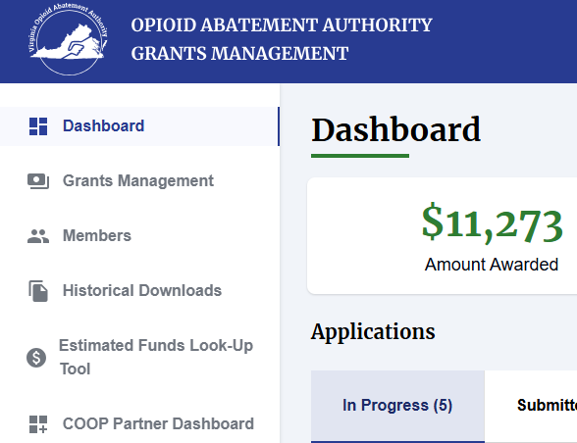
Dashboard Overview cont.

Slide 10
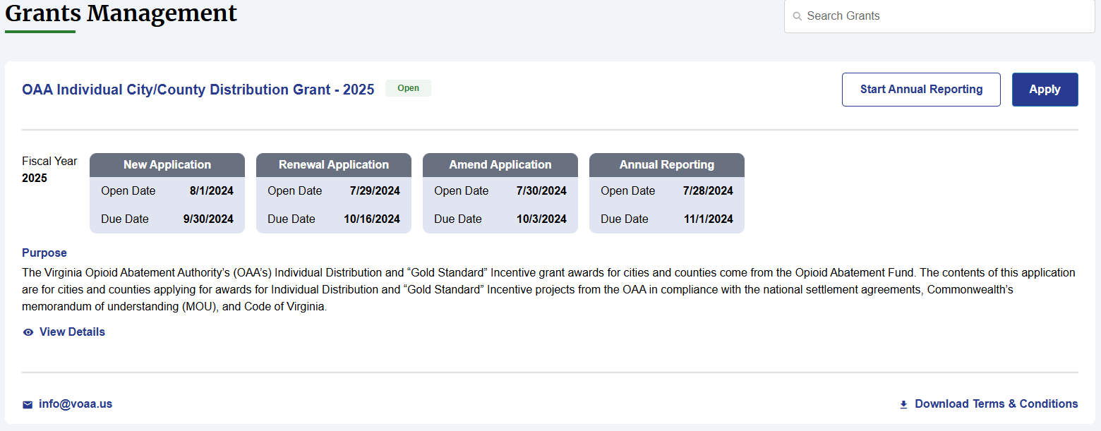
Grants Management Section

Slide 11
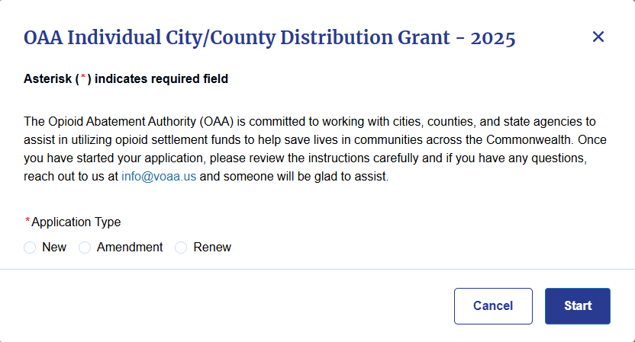
Grants Management Section cont.

Slide 12
Members

Slide 13
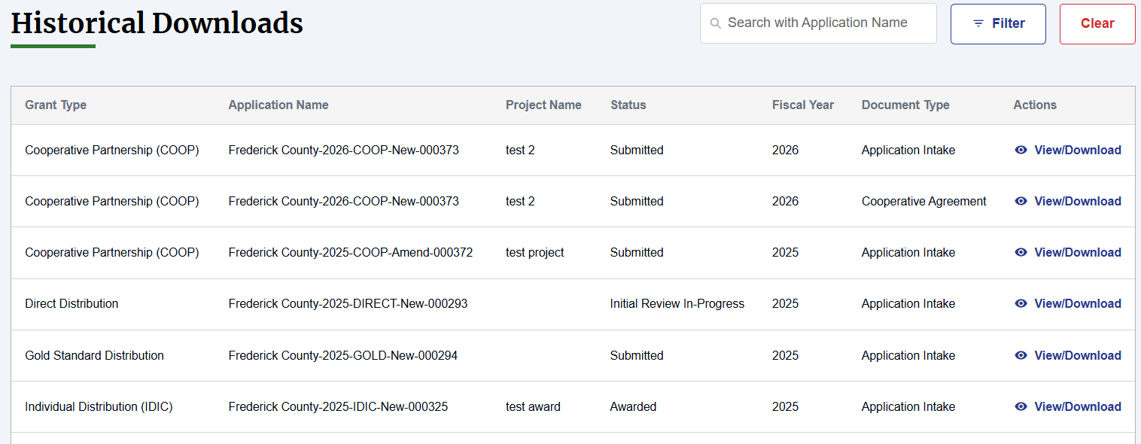
Historical Documents

Slide 14
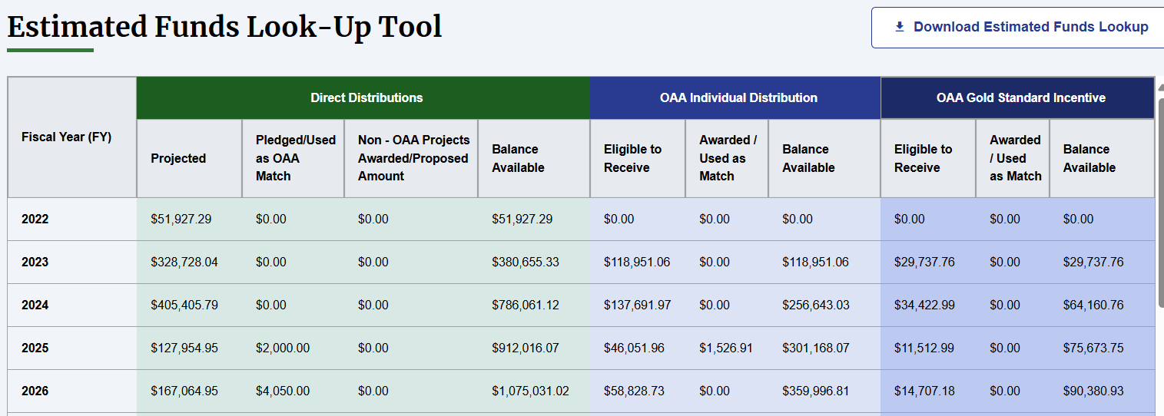
Estimated Funds Look-Up Tool

Slide 15
COOP Partner Dashboard

Slide 16
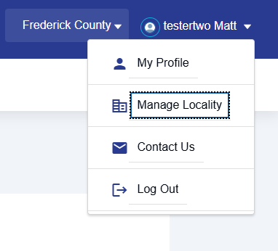
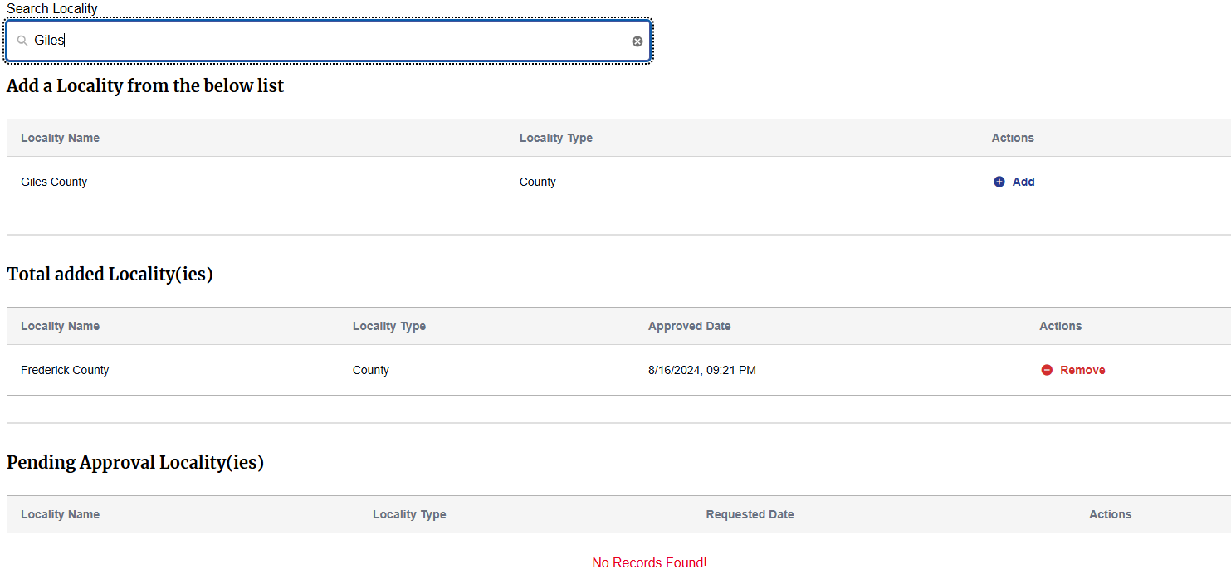
Adding Additional Localities

Slide 17
Grant Application Walkthrough

Slide 18
For more information
Matt Terrill
Sr. Business Analyst
mterrill@voaa.us
(804) 500-1813 office
(804) 629-2155 cell phone
www.voaa.us
Additional Training Session 10/10/2024 @ 10am
Registration link at www.voaa.us/abatement-academy

