Slide 1
Standing up Mobile SUD Treatment Case Studies & "How-To" Guide
Abatement Academy
May 22, 2025

Slide 2
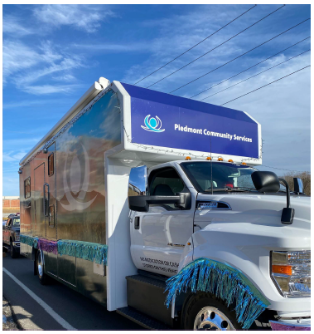
Case Study #1
Piedmont Community Services
Preferred OBAT – Mobile Program
Shannon Clark, MS
Director of Community Support Services
Piedmont Community Services
sclark@piedmontcsb.org

Slide 9
Case Study #2
Rappahannock CSB
Mobile Program
Brandie Williams, M.Ed., Ed.S
Deputy Executive Director
Rappahannock Community Services Board
bwilliams@rappahannockareacsb.org

Slide 10
Rappahannock Area Community Services Board
Dedicated to education, recovery, treatment and wellness for over 50 years
Developmental Disability Day Support and Psychosocial Rehabilitation Services
DD and MH Residential Services
Co-responder MH Services
DD, MH and SUD Case Management
Medicated Assisted Treatment
MH/SUD Outpatient/Medication Management
Child Services, including Mobile Crisis Services
Jail-based and Diversion Services
Veteran’s Docket and Drug Court
24/7/365 Emergency Services
Crisis Stabilization and Detox
Crisis Intervention Team Assessment Center and Training
Assertive Community Treatment
Intermediate Care Facilities
Our motto—“HopeStarters”—speaks to our mission of creating a better tomorrow for many of society’s marginalized patient populations.

Slide 11
Rappahannock Mobile Response Unit: Where hope rides
Expand access to opioid treatment and recovery services outside the walls of the CSB within the community
Provide inductions, urine and saliva drug screens, medication administration, case management, counseling, peer supports, and harm reduction
Team will include program manager, nurse practitioner, CSAC/Therapist, and a peer recovery specialist
Connect individuals to care across all five our localities by removing transportation and access barriers. Serve a minimum of 50-100 individuals annually through the mobile unit
Leverage partnerships with on-site pharmacy provider, Rappahannock Area Health District’s Mobile Unit, other SDOH-focused partners
We have currently received our mobile unit and are in the process of hiring staff. We have started providing support services in our outlying clinics to build program.

Slide 12
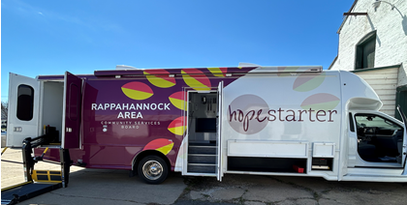

Slide 13
Case Study #3
Hampton Roads Regional Cooperative
“Wellness on Wheels”
Stacey Smith
BH Director
City of Virginia Beach
stsmith@vbgov.com
Heather Strock
Executive Director
Sentara Community Care
hamedfor@sentara.com

Slide 14
Establishing the Partnership
Virginia Beach as fiscal agent was awarded VOAA Planning Grant for FY24 followed by a Regional Cooperative Grant for FY25 for Cities of Chesapeake, Norfolk, Portsmouth, Suffolk, and Virginia Beach.
The 5 Cities engaged with Sentara Health and formed a Public/Private Partnership for this endeavor.
Primary Goal:
To build an effective and sustainable public-private partnership to ensure long-term progress on initiatives to address opioid use disorder in the region and remove barriers to care.

Slide 15
Needs Assessment and Data Analysis
Community Input:
The 5 South Hampton Roads cities sought community input throughout the Summer and Fall of 2023 through community events and surveys to determine community needs as it relates to Opioid Abatement.
More than 200 people attended 15 events hosted across the region by the five cities. Events included:
in-person town halls and smaller listening sessions,
virtual town halls, and
a public safety forum.
Participants included city residents, individuals in recovery, family members of those in recovery, members of the faith community and healthcare providers.
Review of available data:
A comprehensive data analysis found that clear and convincing evidence that the five cities of South Hampton Roads require additional resources and regional collaboration to address the opioid crisis.
The Virginia Department of Health’s (VDH’s) vulnerability assessment tool identifies all five cities are having a critical need for targeted prevention and intervention to reduce drug overdoses.

Slide 16
The Findings
Data Findings indicate that:
More than 1 in 6 opioid overdose deaths in Virginia occurs in South Hampton Roads
On average, one person dies each day in South Hampton Roads due to an opioid overdose.
The age-adjusted hospitalization rates for opioid use in all five cities of South Hampton Roads exceed the state rate.
Total Costs of Opioids in South Hampton Roads in 2021: $812.2 million
Survey results overwhelmingly indicated that:
Same Day Access to Provider
Access to SUD and BH Services in One Place
Access to SUD and Primary Care in One Place
Transportation to Appointments
Access, is the biggest barrier to treatment. The most significant access issues include:

Slide 17
The Plan: Mobile Care Vehicle Throughout All 5 Cities
Sentara
MAT treatment
CSBs
Peer recovery services
Primary care
Mobile vehicle management & operations
Staff to support mobile patient care: medical assistants, driver, security, community health worker
Program coordinator: point person for coordination among cities, CSBs, SCC; engagement activities w/schools, faith-based partners, other CBOs to support youth outreach & health equity goals
Same Day Access clinicians
Outpatient clinicians/therapists
Referral & Care Coordination to connect individuals to ongoing treatment & recovery services
Prevention education
Harm reduction strategies
*Services available on site and via telehealth depending on availability of providers in each city.

Slide 18
Wellness on Wheels Patient Care Path
Patient presents
Assess patient (Sentara intake coordinator/NP)
Medical evaluation (Sentara)
Treatment (Sentara)
Therapy/Prevention/Peer Support Services (City CSBs)
Referral to external partner to continue treatment
(CSBs and/or Sentara)
Testing (Sentara)

Slide 19
Where We Are and What’s Next
Accomplished
Identified services.
Next Steps
MOU between Sentara and Va. Beach and other 4 cities.
Defined roles and responsibilities.
Drafted MOUs.
Final sign-off on mobile design.
Finalize SOPs and workflows.
Develop marketing plan.
Lead community conversations in areas selected.
Selected provider of the mobile unit.
Mapped out mobile design.
Developed workflows and patient care path.
Recruit staff.
Named the project.
Identified initial locations for the vehicle.

Slide 20
Questions from the Audience
Please Type Your Questions or Comments into the Q&A Feature

Slide 21
Virginia Opioid Abatement Authority 701 E. Franklin St., Suite 803 Richmond, VA 23221 email to: info@voaa.us
www.voaa.us

