Slide 1
OAA Grants Management Portal – Communications Training
March 12, 2025
Matt Terrill
OAA Sr. Business Analyst

Slide 2
Communication Functions
Gives constant record of communications between the OAA and cities/counties
Users receive an email notification when mentioned in a question/comment
An OAA employee has tagged the user (@Matt Terrill)
Users attach questions to their account or specify the specific application they are referencing
Users can bookmark questions/comments to find them more easily

Slide 3
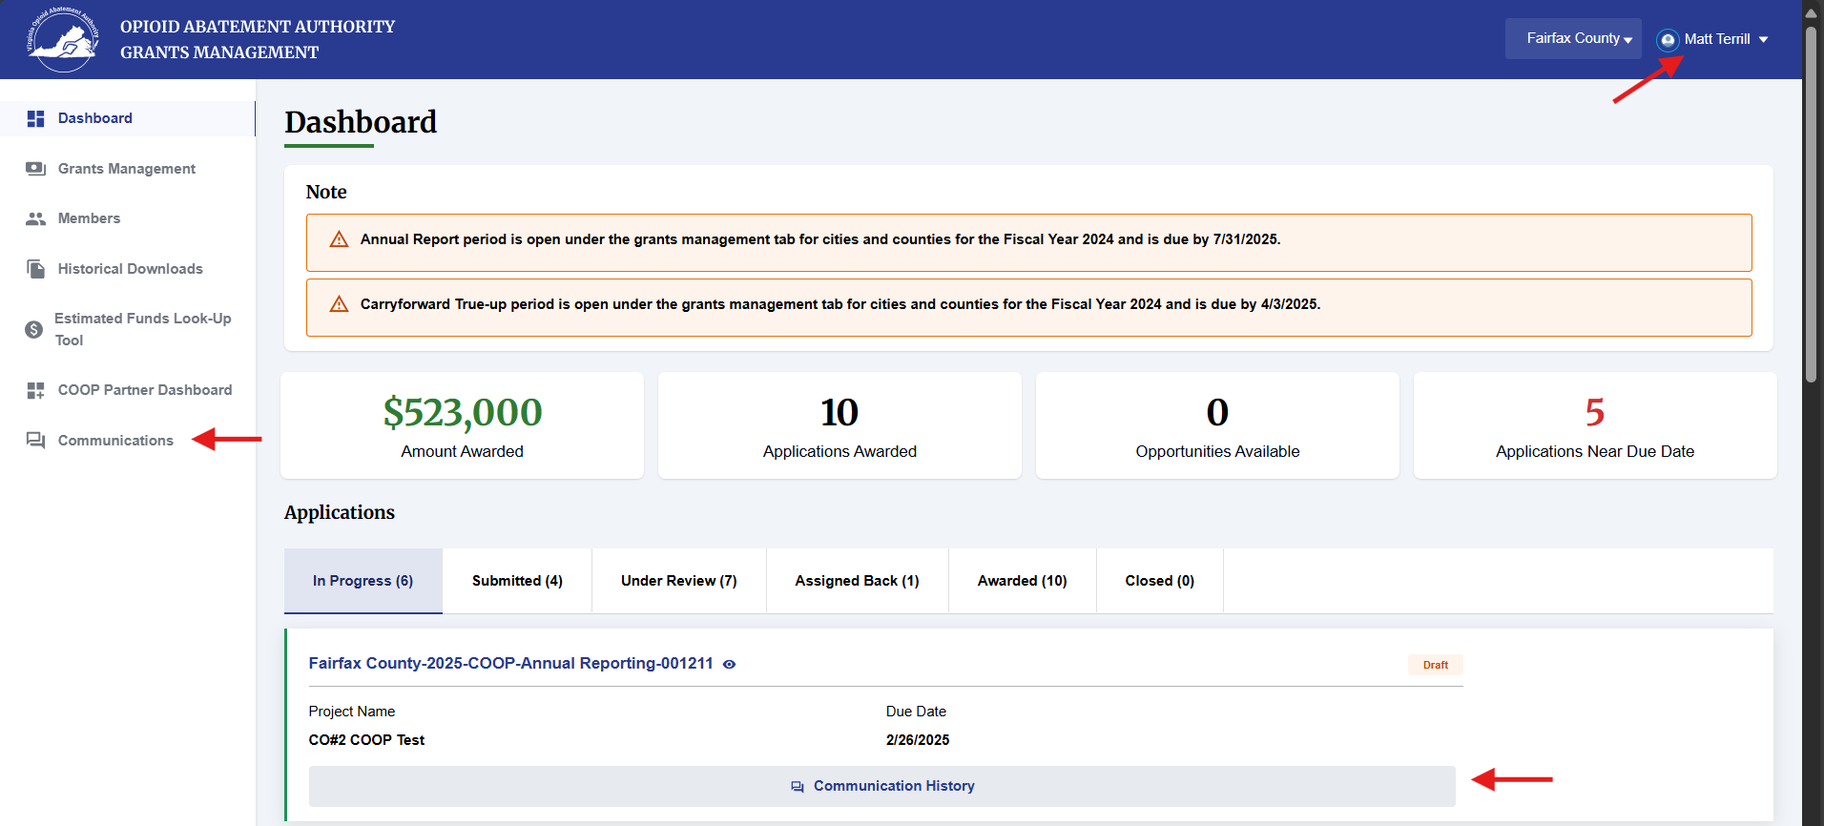
Communications
Notes:
Three ways to access the portal communications
1. Clicking your name in the top right and selecting “Contact Us” in the drop down
2. Clicking “Communications in the sidebar
3. Clicking “Communications History” beneath any application

Slide 4
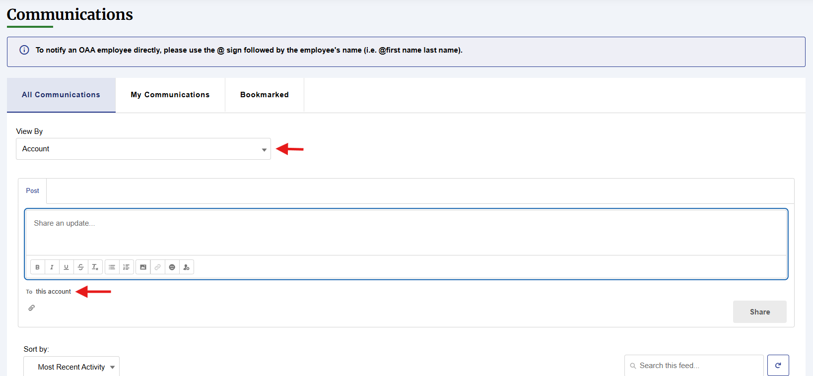
Communications
Notes:
Going to the Communications page either through the Contact Us option or clicking in the sidebar will take you to this screen filtered to the Account level as seen in the dropdown under “View by”. This is for all general communication/questions. You can also ensure that you are posting to the account level in the “Post” section where it says “To this account”.
You can also attach documents to your communications by clicking on the paperclip at the bottom of the “Post” section.

Slide 5
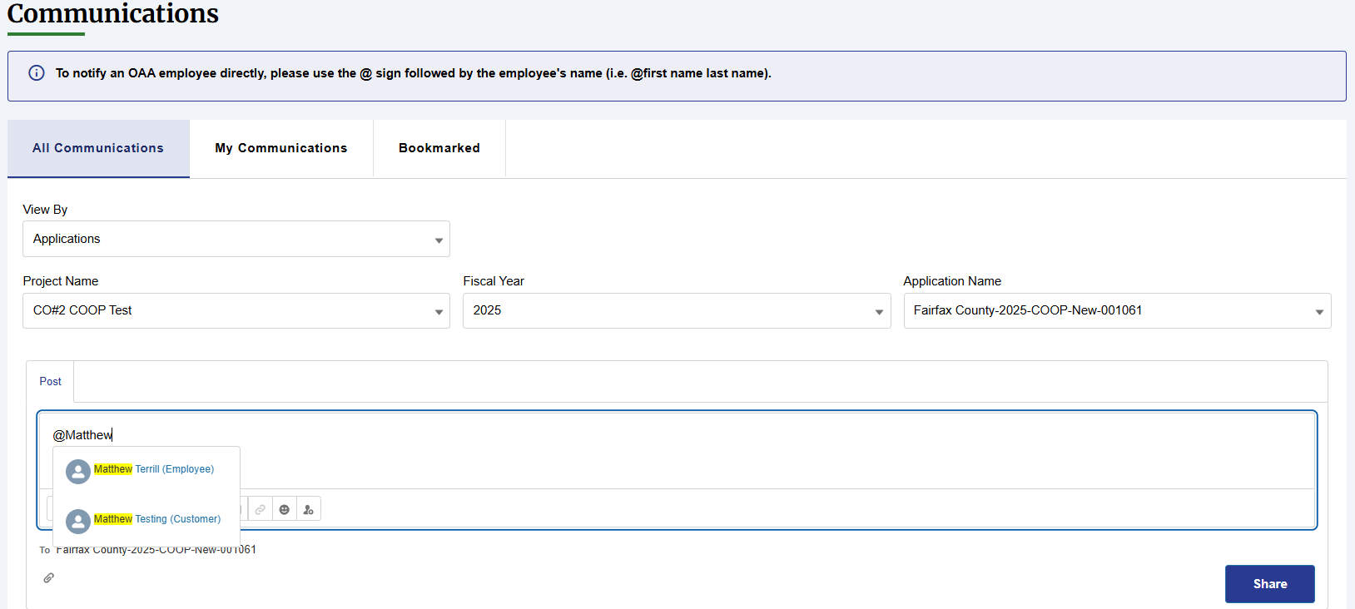
Communications
Notes:
Here is the view of the communications page filtered to a specific application. If you click “Communications History” from the Home Dashboard it will automatically filter to that specific application. You could also use the filters on this beginning by choosing the Project, then the year, then the specific application for that year (New, Amendment, Annual Report, Carryforward Report).
To ensure that we see your question as quickly as possible, you can type the @ symbol then begin typing the name of your Regional Coordinator. You should see their name come up as you can see here with mine and then you will need to click on their name. This will send them an email notification with a preview of your question. Likewise, if your Regional Coordinator is responding/reaching out to you through the communications page, they can tag you in the post and you will receive an email informing you that you have a message with a preview of the message.

Slide 6
For more information
Matt Terrill
Sr. Business Analyst
mterrill@voaa.us
(804) 629-2155 cell phone
www.voaa.us

