Slide 1
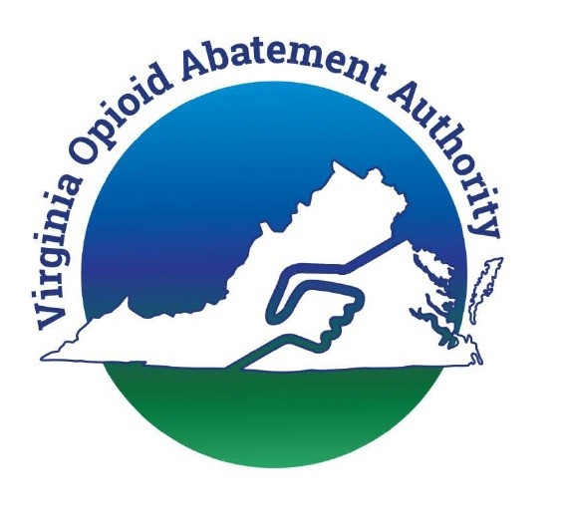
Operation STOP!
Abatement academy session
February 13, 2025

Slide 2
Operation STOP! Overview of Today’s Webinar
Introductions
Brief overview of the OAA
Review of Operation STOP!
Black Faces Black Voices – Philip Rutherford
Virginia Opioid Abatement Toolkit - Dr. Jackie Britz and Ms. Tyler Burton
Q&A

Slide 3
Operation STOP!
Introductions

Slide 4
REVIEW OF THE OPIOID ABATEMET AUTHORITY
& Virginia’s Settlement Distribution Agreement
All efforts funded with settlement dollars must be overseen by a state agency, a county (95) or a city (38).

Slide 5
Decline in overall opioid overdose deaths – creates the risk of “Opioid fatigue”
Shift from over-prescribing and misuse of medications to illicit fentanyl / analogues
Overdose growth in urban areas, particularly among urban Black and Latino communities
Data from the Virginia Department of Health (VDH) from 2019 to 2023:
These trends align with national patterns.
White Virginians: Overdose death rate increased by 11%
Black Virginians: Overdose death rate increased by 41%
KFF News analysis shows national drug overdose rates among Black individuals (47.5 per 100,000) surpass those of White individuals (35.6 per 100,000)
National Institute on Drug Abuse (NIDA) highlighted that between 2015 and 2023
Overdose deaths among non-Hispanic Black men aged 55 and older increased nearly fivefold.
In 2023, deaths in this group were nearly triple the national average for their age demographic, with fentanyl and cocaine as the predominant contributors.
Identifying the Problem
Mixed with stimulants such as cocaine and/or meth.

Slide 6
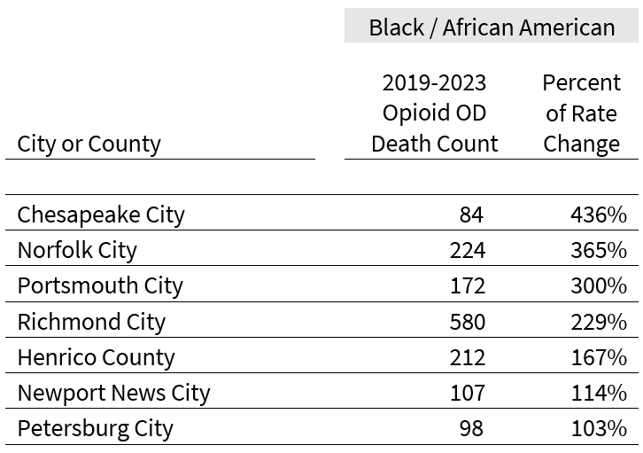
Operation STOP! Eligibility
Virginia cities and counties with disproportionately high opioid overdose death rates among Black individuals from 2019 to 2023.
A 100% or higher increase in Black opioid overdose deaths per 100,000 population from 2019-2023
At least n=20 opioid overdose fatalities within the timeframe.

Slide 7
The OAA will make awards of up to $500,000 per grant award / $3 million in total
Virginia OAA has created Operation STOP!
(Specifically Targeted Overdose Prevention)
Applications are due April 1, 2025
Operation STOP! grants are competitive, only available to the individual cities and counties listed on the previous slide, and the evaluation criteria is established by the Code of Virginia.
Period of performance of July 1, 2025 - June 30, 2027 (TWO YEARS)

Slide 8
MUST partner with at least one community-based organization that has a track record of success in connecting with and successfully serving the specific population.
Operation STOP! Requirements
Applicants should address how the city or county will accomplish the following objectives:
Develop and implement a targeted outreach and communications strategy for that audience.
Identify residents at the highest risk of overdose, and specifically those who may be difficult to reach using traditional outreach and education methods.
Implement or expand harm reduction efforts targeting the identified high-risk population.
Implement or expand treatment and/or recovery support services for this population.
Need a letter of support from that organization submitted with the application.
Specific MOU or contract can be completed after the award is finalized.

Slide 9
The OAA recommends each applicant city or county form an advisory group for the Operation STOP! Grant project. The advisory group composition is recommended to include:
Operation STOP!
Additional Recommendation
Representative(s) from the partnering community-based organization(s).
Individual(s) with lived experience of opioid use disorder.
Local faith-based organization(s).
Local Health Department/District representatives
Emergency medical services (EMS) providers serving the community
Business community representatives (e.g., chamber of commerce, or local private business).
Representatives from local post-secondary institutions who could provide technical assistance.

Slide 10
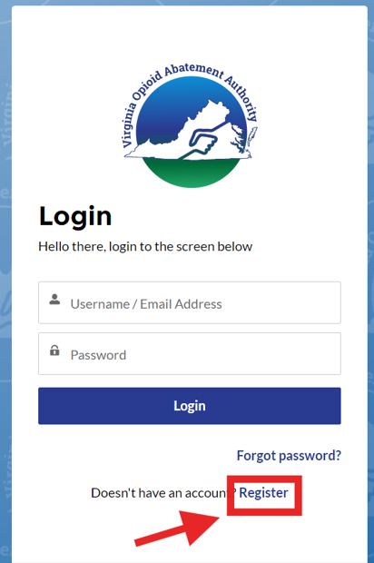
OAA Grants Portal
All city and county grants must be submitted in the OAA Grants Portal.
Each city or county must register one point of contact and up to four additional authorized users.
Instructions for establishing an account can be found at https://www.oaa.virginia.gov/portal-grants/

Slide 11
Black Faces Black Voices
Philip Rutherford
Vice President, Substance Use Continuum
Substance Use Disorders
National Council for Mental Wellbeing
Direct: 202-770-4661

Slide 12
Virginia Opioid Abatement Toolkit February 13, 2025
Jacqueline Britz, MD MSPH
Tyler Burton, MPH
Department of Family Medicine
and Population Health

Slide 13
The OAA Toolkit
Collaborative, community-engaged project by VCU and Virginia Society of Addiction Medicine, funded by the OAA
Evidence-based toolkit for cities and counties to aid use of OAA funds
In the future, we aim to feature community-specific data and resources to facilitate programs and partnerships
Key components
Toolkit based on the nine opioid settlement use categories
Evaluation of gaps and what is needed
Evaluate promising interventions
Community outreach
Provide consultation to cities and counties
Department of Family Medicine
and Population Health
Notes:
Responsive and adaptive to local needs, challenges, priorities

Slide 15
Preview of The Toolkit
virginiaopioidtoolkit.org/

Slide 16
Visit the Operation Stop! Section of the Toolkit: virginiaopioidtoolkit.org/operation-stop/
The Operation Stop! Section is dedicated to assisting urban localities with mitigating disproportionate fatal overdoses among Black residents.
https://virginiaopioidtoolkit.org/operation-stop/

Slide 17
What can you find in this section?
Evidence Based Strategies Applicable to Urban Localities
State and National Examples of Programs

Slide 18
Evidence based tools and promising strategies
Examples of Promising strategies
Resources for Implementing Interventions

Slide 20
COMING SOON!
Conduct a comprehensive needs assessment
Build local capacity resources, and infrastructure
Evaluation
Steps for Implementing Opioid Programming in Your Community
Engage community partners
Implementation Process

Slide 21
Outline
Next Steps
We want to hear from you!
Identify Priorities
Integrating Community Context with Socioecological Data
Refine Toolkit
Expand Menu of Evidence-Based Programs
Translate Evidence into Practice
Support Communities in Implementing Best Practices
Department of Family Medicine
and Population Health
Notes:
3 goals:
Help communities understand key priority areas
Have a menu of evidence based programs
Learn from communities – to understand best practices
Make community specific recommendations based on local needs and community identified gaps by integrating brightspot and healthlandscape data, meet with communities, conducting and conducting a community needs assessment survey
Questions or suggestions for tool kit: Successes, gaps and challenges, toolkit design - data points, interpretation

Slide 22
Acknowledgements
Opioid Abatement Authority, Tony McDowell
Virginia Society of Addiction Medicine
VCU Team: Alex Krist, Gerry Moeller, Jackie Britz, Marshall Brooks, Tyler Burton, Leah Gregory, Ben Webel, Roy Sabo, Jong H. Lee, Adam Funk, Leslie Bobb, Luke Johnson
Virginia Department of Health
VCU C. Kenneth and Dianne Wright Center for Clinical and Translational Research
Department of Family Medicine
and Population Health

Slide 23
Questions or Comments?
Contact Tyler Burton, MPH
toolkit@vcu.edu
Department of Family Medicine
and Population Health
Notes:
Check out our “get in touch” page of website

Slide 24
www.voaa.us
Tony McDowell
Executive Director
tmcdowell@voaa.us
(804) 572-8718

